Slide 1


THE CANADIAN REGISTRATION BOARD OF OCCUPATIONAL HYGIENIST
ROHTM-The Mark of Professional Competence-ROHTTM
32ND ANNUAL GENERAL MEETING
TUESDAY, MAY 21ST, 2019
HYATT REGENCY HOTEL – MIRAGE ROOM
MINNEAPOLIS, MN

Slide 2
AGENDA
Approval of Agenda
Approval of Minutes of the 2018 AGM
President’s Report
Treasurer’s Report
Registrar’s Report
Committee Reports
  External Affairs
  Communications
  By-Laws
  ROH Examination
  ROHT Examination
  Registration Maintenance
  Registration Maintenance Points
  Promotion
Members’ Discussion
Other Business
Adjournment

Slide 3
APPROVAL OF AGENDA & 2018 MINUTES
Motion to approve 2018 minutes
  Second
Motion to Approve 2019 Agenda
  Second

Slide 4
PRESIDENT’S REPORT
KEN KEILL

Slide 5
PRESIDENT'S REPORT
A federally incorporated, not-for-profit organization, which sets standards of professional competence for occupational hygienists and occupational hygiene technologists in Canada.
Registration with the CRBOH confers the right to use the professional designation and title:
Registered Occupational Hygienist (ROHTM)
Registered Occupational Hygiene Technologist (ROHTTM)
What is the CRBOH?

Slide 6
PRESIDENT'S REPORT
To advance the professional practice of occupational hygiene by defining minimum levels of professional & technical competence.
To register & accept as members those applicants demonstrating such competence.
To prescribe standards of professional & ethical conduct.
To further the practice & foster the profession of occupational hygiene in Canada and internationally.
CRBOH’s Mission

Slide 7
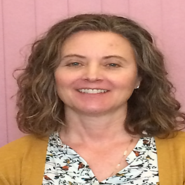
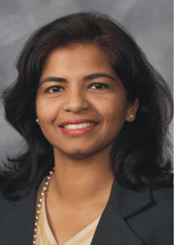
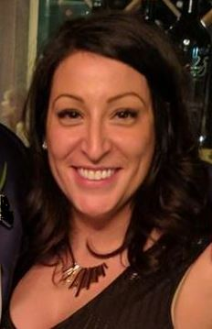
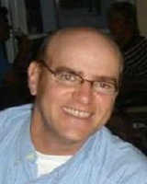
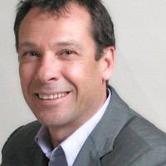
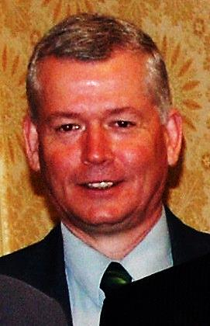
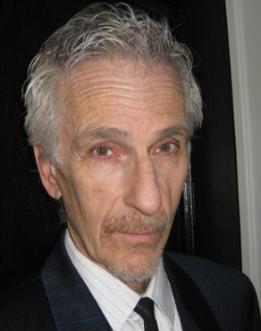
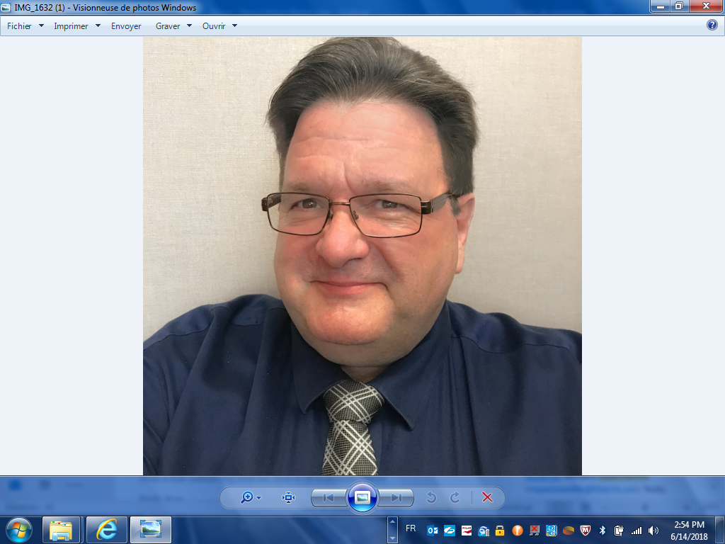

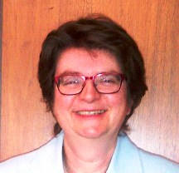
PRESIDENT’S REPORT
2018-2019 BOARD OF DIRECTORS
Michele Kutz
ROH-Central
& Western Prov.
(2017-2020)
Shamini Samuel
ROH-Central
& Western Prov.
(2018-2021)
Sarah McCurdy
ROHT-Central
& Western Prov.
(2018-2021)
René Leblanc
ROH-Quebec
(2017-2019)
Marc Andre Lavel
ROH-Quebec
(2018-2021)
Ken Keill
ROHT-Eastern
(2017-2019)
Mike Welsh
ROH-Ontario
(2017-2020)
Richard Quenneville
ROH-Ontario
(2018-2021)
Richard Blais
ROH-Atlantic Provinces
(2017-2019)
Liz Krivonosov
Registrar

Slide 8
PRESIDENT'S REPORT
Strong effort on Promotion (banners), presence at conferences
Working towards implementation of online membership database (Wild Apricot) and new website
Purchased GICs to ensure financial stability
Review of Oral Exam process to assess sustainability of future examiners
Involvement with IOHA
Development of a Strategic Plan (draft)
2018 – 2019 Highlights

Slide 9
TREASURER’S REPORT
SARAH MCCURDY

Slide 10
TREASURER'S REPORT
Financial Position
ASSETS-Current | 2016 | 2017 | 2018
Cash and cash equivalents | $107, 864 | $116, 061 | $50,870
Short term investments | $20,128 | $20,066 | $30,689
Prepaid expenses | $1,319 | $2,979 | $9,066
TOTAL | $129,311 | $139,106 | $90,625
LIABILITIES -Current | 2016 | 2017 | 2018
Accounts payable and accrued liabilities | $6,181 | $5,844 | $7,068
Deferred Revenue | $23,370 | $25,420 | $35,670
TOTAL | $29,551 | $31,264 | $42,738
Audited Financial Statement

Slide 11
TREASURER'S REPORT
Statement of Revenue
REVENUE | 2016 | 2017 | 2018
Exam Fees | $10,375 | $8,150 | $6,675
Membership Dues | $71,259 | $70,065 | $70,200
Job Postings | $3,500 | $6,000 | $4,000
Interest Income | $149 | $149 | $783
TOTAL | $85,283 | $84,364 | $81,658
Audited Financial Statement

Slide 12
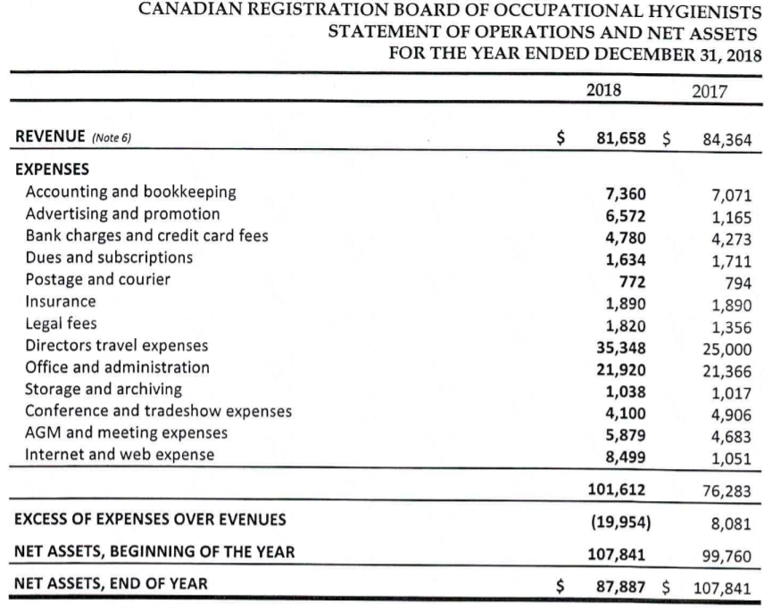
TREASURER'S REPORT
Statement of Operations and Net Assets

Slide 13
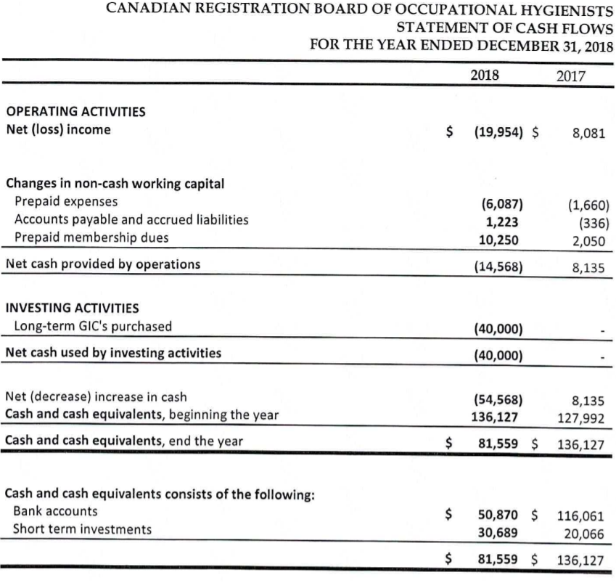
TREASURER'S REPORT
Statement of Cash Flows

Slide 14
TREASURER'S REPORT
“We have audited the accompanying financial statements…
“Management is responsible for the preparation and fair presentation …
“Our responsibility is to express an opinion … based on our audit…
“We believe that the audit evidence we have obtained is sufficient & appropriate to provide basis for audit opinion…
“In our opinion, the financial statements present fairly, in all material respects, the financial position of CRBOH as at Dec 31, 2018 … in accordance with Canadian accounting standards for not-for-profit organizations.”
Appointment of Auditor for 2018
Turner Moore Charted Accountants, Ontario
Independent Auditor’s Report

Slide 15
MOTION TO APPROVE 2018 AUDITOR’S REPORT
Motion to approve 2018 Audit
Second to approve 2018 Audit

Slide 16
REGISTRAR’S REPORT
LIZ KRIVONOSOV

Slide 17

REGISTRAR’S REPORT
5 EXAMINATION TYPES
Membership comprised of:
  Revewals of current members
  Examinations
ROHT
M/C & Essay
NAR
Oral
ROH
M/C & Essay
Oral
ROH Fast Track 1
M/C only
ROH Fast Track 2
Essay Only

Slide 18



REGISTRAR’S REPORT
NAR PROCESS
Applicants who currently hold a certification (e.g. CIH) endorsed by the National Accreditation Recognition Committee of IOHA
  Are exempt from ROH written examination component
  Challenge the ROH oral examination directly

Slide 19

WHAT DOES OUR MEMBERSHIP LOOK LIKE ACROSS CANADA

Slide 20
Total Membership: 2010-2018

Slide 21
Total Exam and new Memberships
(2015-2019)
2019 Exam results not available

Slide 22
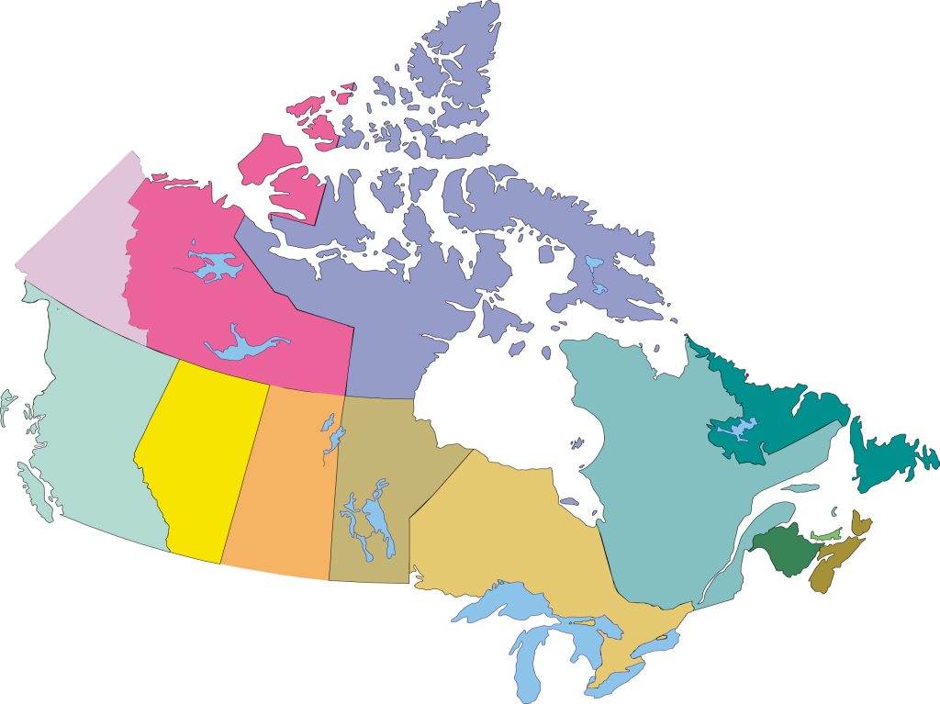
ROHT 2018
Total: 66
Retired in 2018: 2
International: 0
1
7
31
1
1
1
1
1
19
3

Slide 23

REGISTRAR'S REPORT
New CRBOH ROHT Members 2018
Congratulations and welcome to our newest ROHT members (2018):
Petrocelli Cordero
Adam Stokowski

Slide 24
ROH 2018
Total: 280
Retired in 2018: 15
International: 25
1
28
51
4
8
3
1
26
4
119
11

Slide 25
REGISTRAR’S REPORT
NEW ROH MEMBERS
WRITTEN ROH
NAR ROH
Victoria Arrandale
Robbie Carrozza
Jennifer Francis
Kelleigh Grant
Sian Jones
John Kocjan
Kia Lidster
Sameer Roy
Ryan Campbell
James Crichton
Jason Dent
Kelly MacRitchie
Jonathan Truefitt
Robert Vitek

Slide 26
COMMITTEE REPORTS

Slide 27
EXTERNAL AFFAIRS REPORT
RENE LEBLANC & MICHELE KUTZ

Slide 28
EXTERNAL AFFAIRS
CRBOH involved with IOHA
International Occupational Hygiene Association(R. Leblanc chair of IOHA Communication Committee)
  Modification of IOHA website
  Discussion with ICOH executives and increased partnership between our two association
  Joint Statement Tuberculosis/Silicosis
Presentation of ROH/ROHT at AQHSST conference
Presence at AIHcE in Philadelphia. RL member of AIHAs Governmental Affair and International Relation committee
Met with CSSE – Quebec Section in June 2018

Slide 29

EXTERNAL AFFAIRS
The Alberta Society of Health and Safety Professionals (ASHSP) aims to
transform the practice of occupational health and safety into a profession that is fully recognized and protected under Alberta provincial law to protect Albertans.
CRBOH has two board members on the Executive Board of the Alberta Society of Health and Safety Professionals (ASHSP);
Shamini Samuel was recently re-elected for a second term at the 2019 ASHSP Annual General Meeting (AGM) in April;
Michele Kutz was recently re-appointed for a second term at the 2019 ASHSP AGM in April;

Slide 30
EXTERNAL AFFAIRS
CRBOH supports the ASHSP initiative because competent occupational hygiene professionals play an essential role in reducing occupational disease in the workplace.
We believe a vigorous system of professional practice protection and title protection with well-defined and defensible skill sets administered by an organization (ASHSP) is what is needed to reduce occupational disease - the leading cause of fatalities in Alberta.
http://www.ashsp.ca/

Slide 31
COMMUNICATIONS COMMITTEE REPORT
MICHELLE KUTZ & SARAH McCURDY

Slide 32


COMMUNICATIONS REPORT
New website and membership database (Wild Apricot)
  Automation
  Consolidate communication with membership database
  Eliminate duplication
Key milestones
  New webmaster
  Migrate communication templates
  Migrate website and membership information

Slide 33

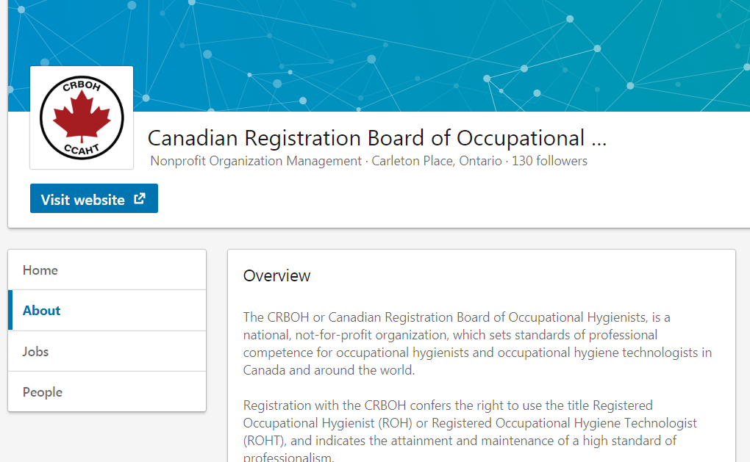
COMMUNICATIONS REPORT
Use Linkedin to promote ROHT/ROH designation
130 followers – LinkedIn CRBOH Company Page
220 – LinkedIn Members on our private group
https://www.linkedin.com/company/crboh

Slide 34
ROH & ROHT EXAM COMMITTEE REPORTS
CHAIR: PAUL BOZEK (ROH)/DAVE JARRELL (ROHT) BOD LIAISON: RICHARD BLAIS/KEN KEILL

Slide 35
ROH EXAM COMMITTEE REPORT
2019 COMMITTEE MEMBERS
WRITTEN EXAM LOCATIONS (MARCH 2019)
Andrea Janzen
Andrea Sass-Kortsak
Carl Woychuk
Cindy O’Brien
Kathy Smolynec
Sanda Deike
Subhash Danekar
Toronto
Calgary
Vancouver
Ottawa
Winnipeg
Saskatoon
Montreal

Slide 36
ROH EXAM COMMITTEE REPORT
CHIEF ORAL EXAMINERS (COE)
ORAL EXAM (OE) PANEL MEMBERS
Toronto
  Cindy O’Brien
  Paul Bozek
  Yang Ting Shek
Ottawa
  Darren McPherson
Halifax/St.John’s
  Jason MacInnis
Calgary
  Tiffany Clayton
  Marshall Denhoff
  Shamini Samuel
Andrea Sass-Kortsak
Lydia Renton
Guillaume Lachapelle

Slide 37
ROHT EXAM COMMITTEE REPORT
2019 COMMITTEE MEMBERS
Chair : Dave Jarrrell
BOD Liaison : Ken Keill
ROHT Exam Process
  Independent and separate from the ROH Exam
David Jerrell and the Registrar have copies of the exam questions
David makes the exam and sends to the proctors
ROHT is kept separate from the ROH influence
Corry Devos
Pierre Frenette
Paul Verma
Shout out to: Mike Phibbs, Clemscape for office use
WRITTEN EXAM LOCATIONS (MARCH 2019)
Calgary
Newfoundland

Slide 38
REGISTRATION MAINTENANCE/POINTS COMMITTEE REPORT
CHAIR: MARGARET FUNG BOD LIAISON: RICHARD BLAIS

Slide 39
ROH REGISTRATION MAINTENANCE
2019 CRBOH MEMBER
VOLUNTEERS
Graham Blackshaw
Anjie Davis
Michael Grey
Jodi Johnson
Lydia Renton
Gerry Saunders
Krista Thompson
Letty Wong
Wayne Wood
Total ROH Worksheets Due (45) | # | %
Eligible for renewal | 42 | 93%
Retirees | 3 | 7%
Eligible for Renewal (42) | # | %
Successful re-registrants | 33 | 78%
Audited | 4 | 10%
Worksheets pending | 5 | 12%

Slide 40
ROHT REGISTRATION MAINTENANCE
Total ROHT Worksheets Due (9) | # | %
Eligible for renewal | 8 | 89%
Retirees | 1 | 11%
Eligible for Renewal (8) | # | %
Successful re-registrants | 6 | 75%
Audited | 1 | 12.5%
Worksheets pending | 1 | 12.5%
2019 CRBOH MEMBER
VOLUNTEERS
Matthew Brewer
Kathy Rohl

Slide 41
REGISTRATION MAINTENANCE POINTS REPORT
 | 2014 | 2015 | 2016 | 2017 | 2018 | 2019 (YTD)
Course and Events Approved | 116 | 98 | 27 | 31 | 20
2018– 2019 UPDATES
This will be Margaret Fung’s last year as Chair of this committee, since taking on the role in 2013.
Over the next few months, Margaret will be transitioning over the duties to the incoming chair, Jodi Johnson.

Slide 42
PROMOTIONS COMMITTEE REPORT
CHAIR: MICHAEL WELSH
BOARD MEMBER: SHAMINI SAMUEL
VOLUNTEER: ERIN PEIRCE

Slide 43
PROMOTIONS COMMITTEE
To promote the mission of CRBOH to various stakeholders and interest groups including prospective registrants, CIH’s, other Occupational Hygiene organizations, allied professions, companies, and government agencies.
Responsible for recommending promotional activities to BOD.
Objective

Slide 44
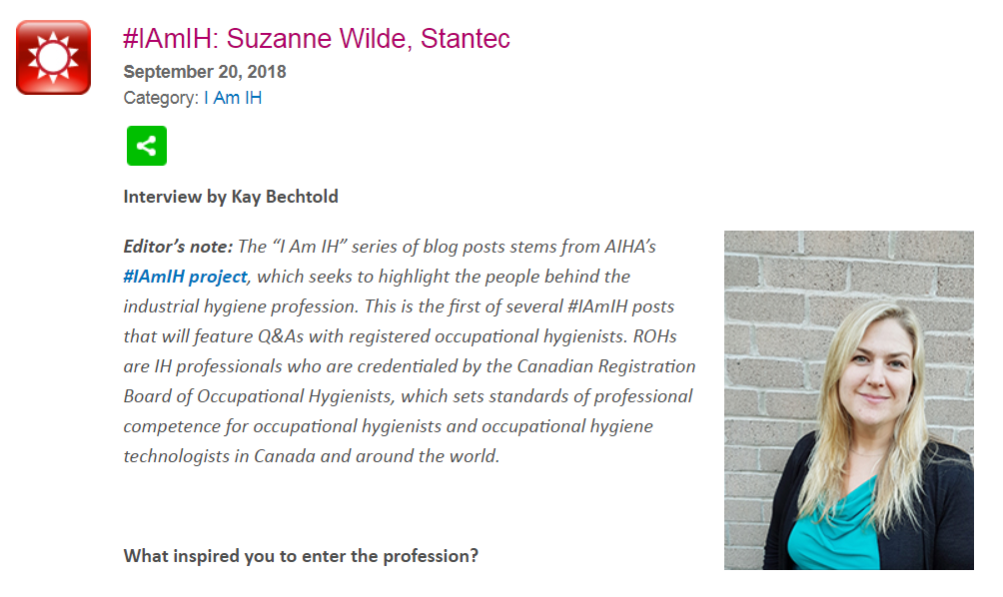
PROMOTIONS COMMITTEE
Banners designed, manufactured, and distributed to Directors in:
- Quebec
- Ontario
- Alberta
Agreement with AIHA to include ROH’s in their IamIH blog series. (one entry completed)
  Suzanne Wilde https://www.aiha.org/publications-and-resources/TheSynergist/SynergistNow/Lists/Posts/Post.aspx?ID=160
Activities

Slide 45
PROMOTIONS COMMITTEE
Development of core Promotions powerpoint presentation for adaptation to various audiences.
Continued study of title protection and scope of practice protection, coinciding with creation of the Alberta Society of Health and Safety Professionals.
Delivery of powerpoint presentation adapted for title protection case to OHAO AGM Oct 2018, Mississauga.
Completed FPT Jurisdictional Scan through CAALL-OSH to determine legislated and non-legislated references to Occupational Hygiene in all FPT jurisdictions.
  (for use in title protection review)
Activities

Slide 46
PROMOTIONS COMMITTEE
Purchased 500 promotional pens for distribution at conferences.
Ongoing work researching design and supply of new CRBOH lapel pins.
2019 Student Award
This year our student award winner was:
  Maryam Khan – University of Toronto
Activities

Slide 47
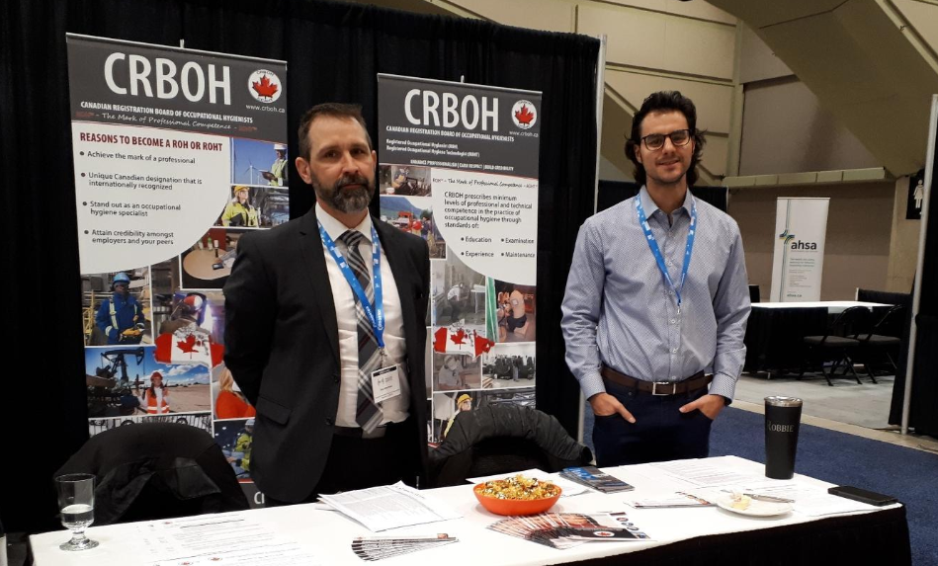
PROMOTIONS COMMITTEE - ACTIVITIES
February 21/22 CRBOH representatives attended the 17th Annual Alberta Health and Safety Conference

Slide 48

Video - What is Occupational Hygiene?

Slide 49
OTHER BUSINESS -
NEW AND OUTGOING DIRECTORS
KEN KEILL

Slide 50

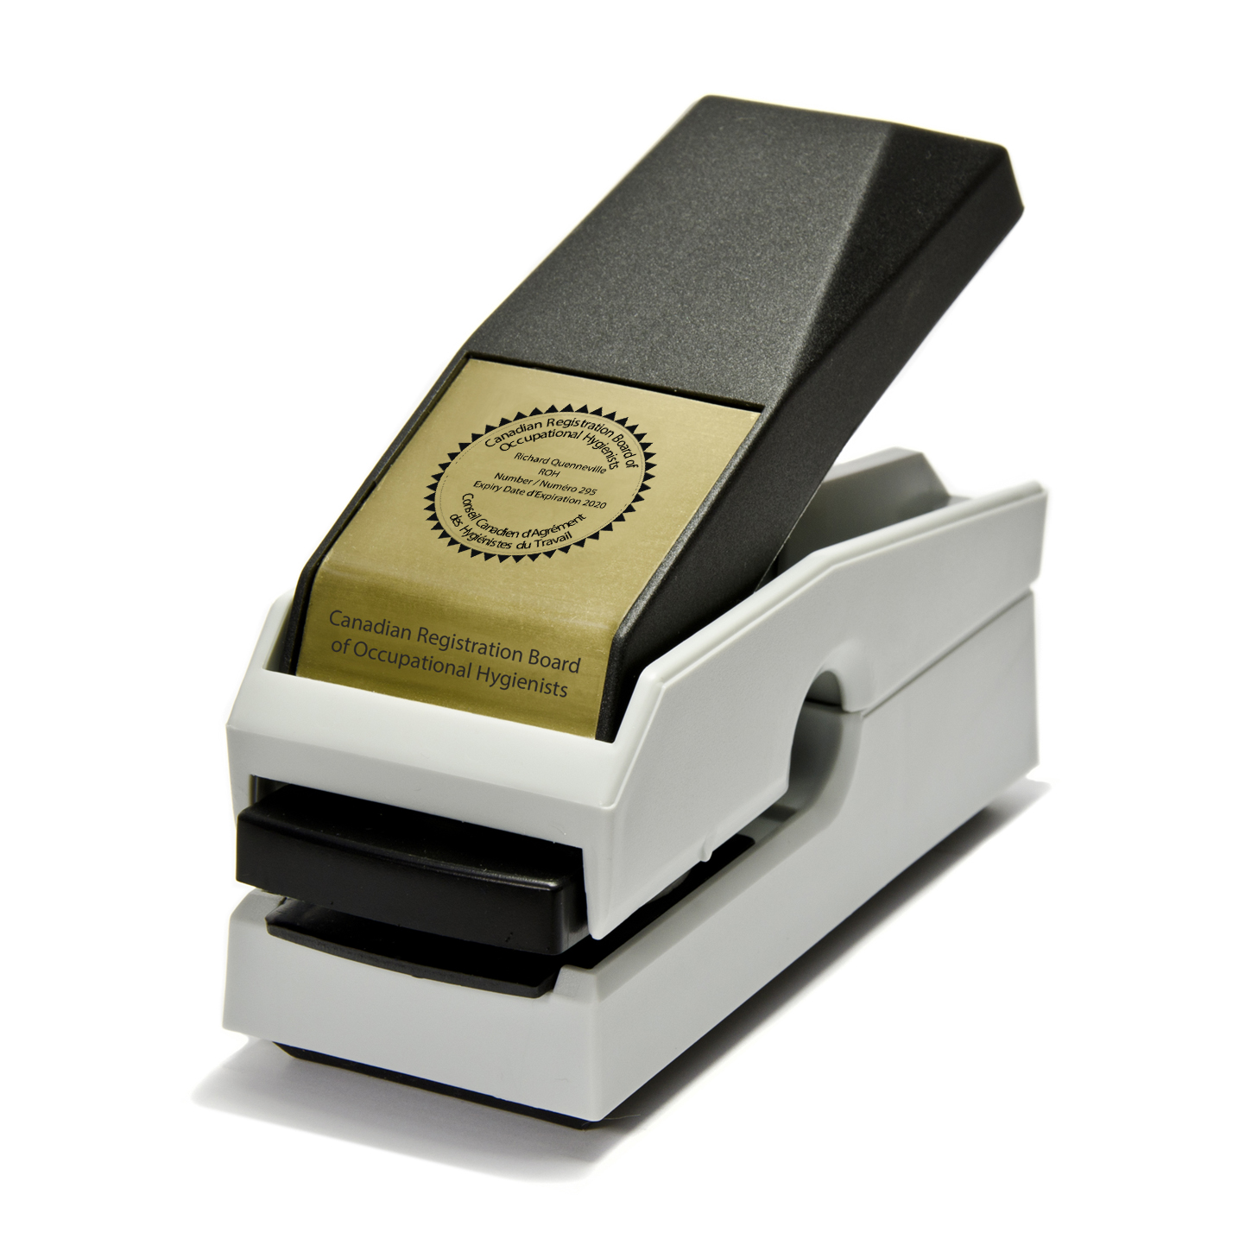
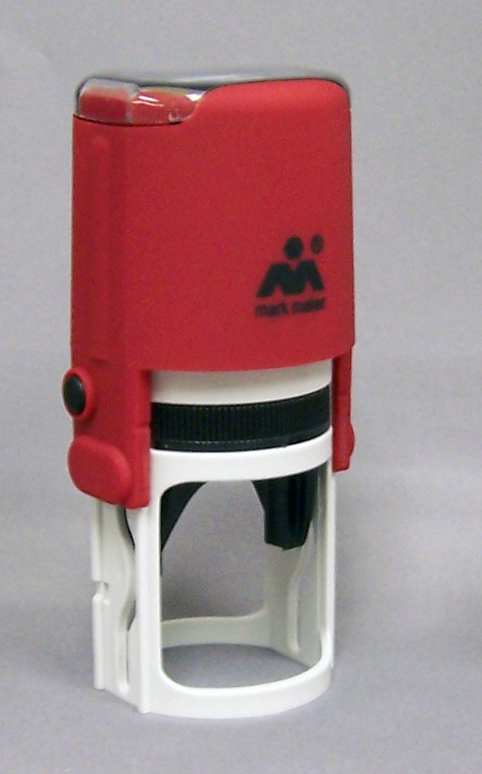
CRBOH Branding ROH / ROHT Seals
Notes:
Order from CRBOH website; self inking stamp $50 + HST; embosser seal $65 = HST; replacement ink pads $$7.99 shipping $16

Slide 51
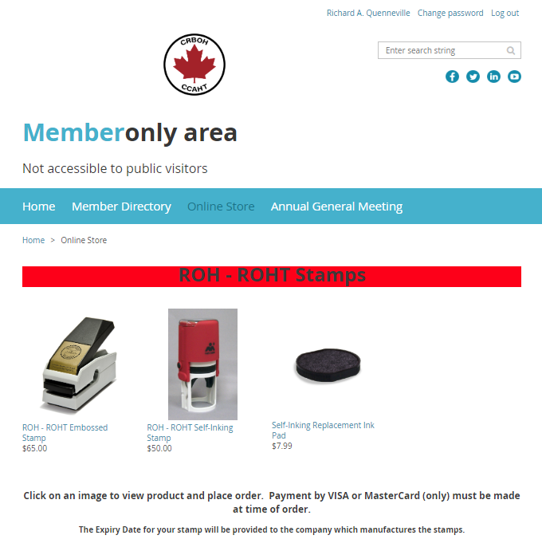
Notes:
Embosser shipped in 2 – 3 business days and stamp in 3 – 5 business days to member

Slide 52
INCOMING PRESIDENT
2019 – 2020
Richard Quenneville

Slide 53

NEW DIRECTORS
ROHT – EAST
Matthew Brewer is an Occupational Health and Safety Consultant for the Province of Nova Scotia. Born and raised in New Brunswick, Matthew has worked in the consulting field for several decades, bringing his occupational hygiene expertise to a variety of projects.
Matthew has conducted specialized Hazmat work in the Arctic, worked at refineries and other industrial facilities in Atlantic Canada, and conducted air quality projects of all sizes around the Maritimes.
His educational background includes training in Environmental Technology at Holland College in Prince Edward Island and Occupational Health and Safety at University of New Brunswick. He also holds designations with IOSH and BCRSP.
Outside of work, Matthew has taken up running, and enjoys travelling to unusual destinations.
Matthew Brewer
2019 - 2022

Slide 54
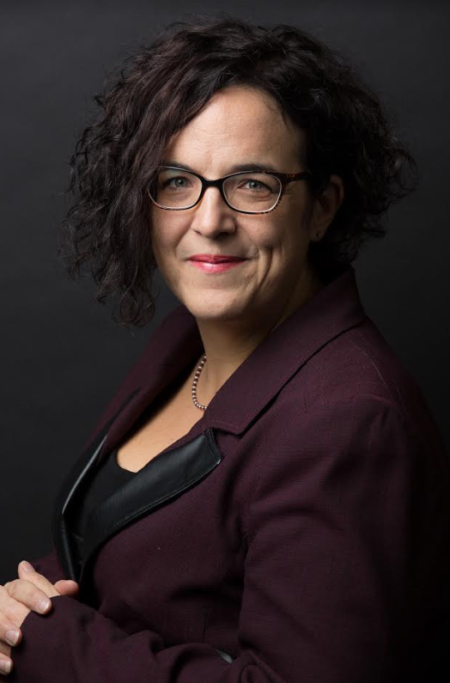
NEW DIRECTORS
ROH - QUEBEC
Lucie Marcotte has solid experience in the field of science marked by a significant multidisciplinary profile. In 2005, after completing a Bachelor's degree in Chemistry at the Université de Sherbrooke, she completed doctoral studies combining chemistry and microbiology. Subsequently, she worked as a coordinator of a biosensor research center, while piloting research projects in biomedical engineering at McGill University.
As part of the Benjel team since 2008, Lucie has developed a passion for the field of occupational health and the environment. Having become an expert in fungal health, she completed a certificate in graduate studies at the School of Public Health of the Université de Montréal in environmental health and occupational health and finally joined CRBOH in 2015 as ROH.
Lucie likes contact with people. She has been involved in various organizations as a volunteer throughout her life. She loves the arts and nature. She dreams of travelling the continent with her family in her RV.
Lucie Marcotte
2019 - 2022

Slide 55
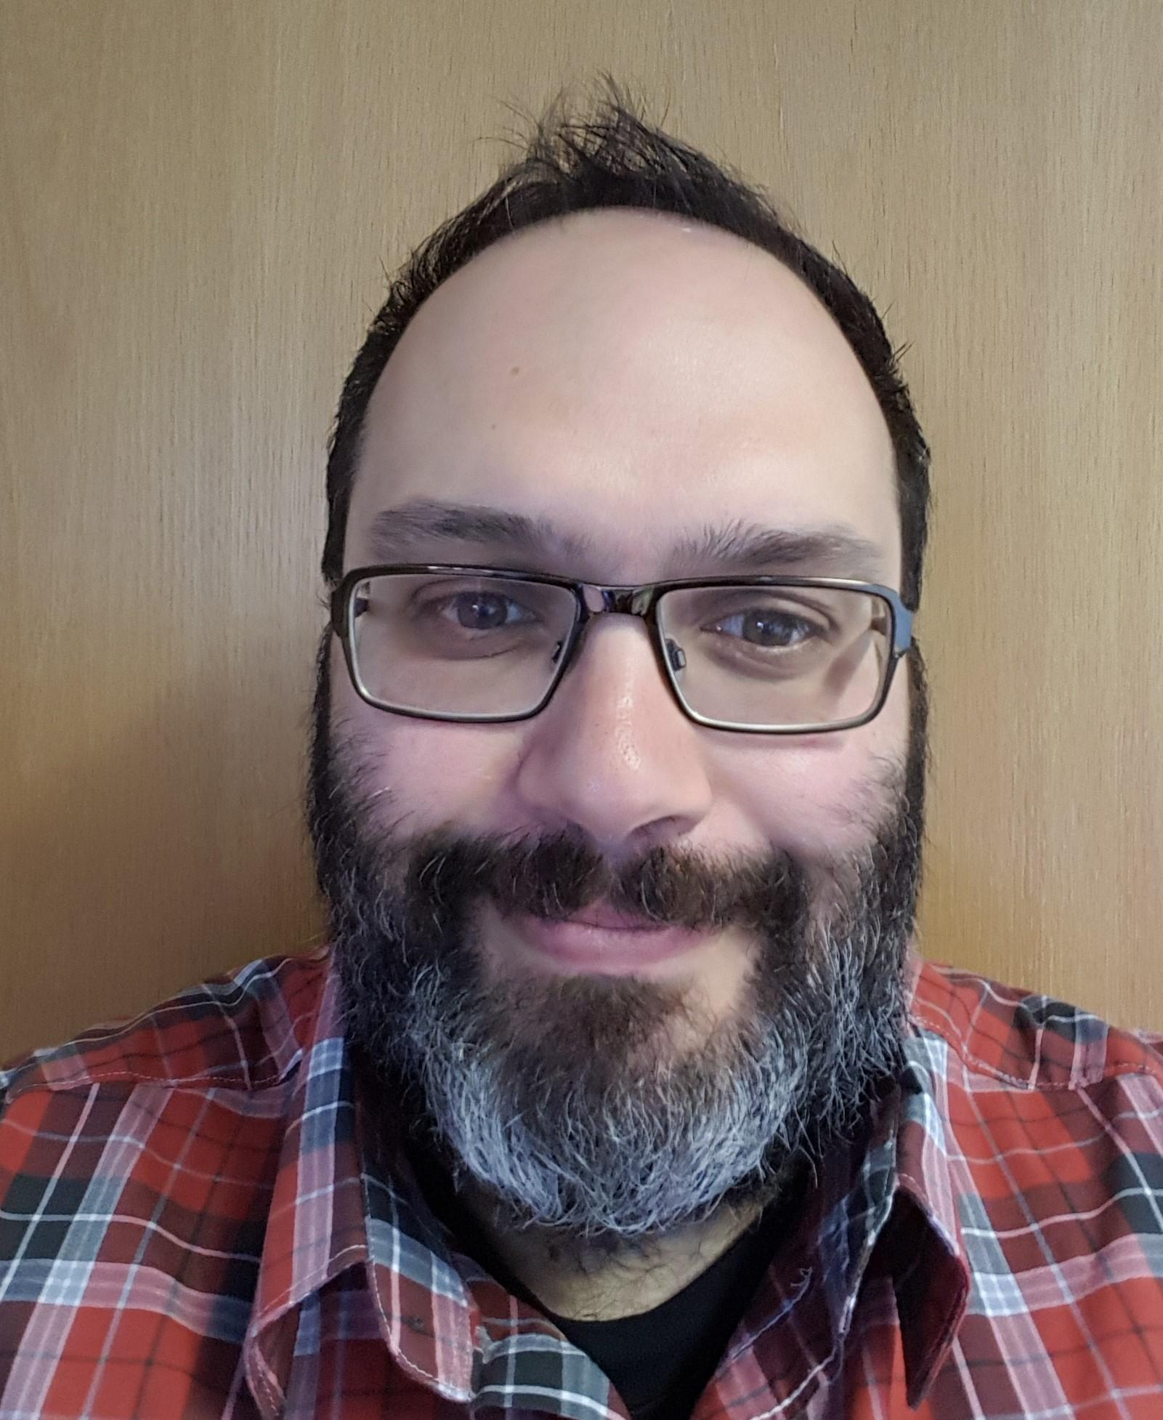
NEW DIRECTORS
ROH – ATLANTIC PROVINCES
Roberto Sgrosso is an Occupational Hygienist and has worked with WorkSafeNB for the last 15 years. He is certified by both the American Board of Industrial Hygiene as a certified industrial hygienist (CIH) and the Canadian Registration Board of Occupational Hygienists as a registered occupational hygienist (ROH).
Roberto has worked with many different industries throughout the Province of NB in his capacity of Occupational Hygienist and has recently transitioned into the Health and Safety Officer Trainer; working on developing and implementing a consistent and sustainable training program. Roberto is also the Provincial WHMIS Coordinator, representing New Brunswick on several national committees and working with Health Canada to enforce the Federal legislation of WHMIS.
Along with being appointed as the Atlantic Provinces Director for the Canadian Registration Board of Occupational Hygienists, he sits as the NB Director of the American Industrial Hygiene Association – Atlantic Provinces Section.
Roberto Sgrosso
2019 - 2022

Slide 56
OUTGOING DIRECTORS
THANK YOU FOR YOUR HARD WORK & CONTRIBUTIONS TO THE BOARD.
Ken Keill, ROHT (East)
Rene LeBlanc, ROH (Quebec)
Richard Blais, ROH (Atlantic Provinces)

Slide 57

MEMBERS’ DISCUSSION & OTHER BUSINESS

Slide 58
CRBOH 32ND ANNUAL GENERAL MEETING
Motion to adjourn the meeting
  Second

Slide 59

THANK YOU FOR
COMING TO THE 2019 AGM

