Slide 1

THE CANADIAN REGISTRATION BOARD OF OCCUPATIONAL HYGIENISTS
ROHTM-The Mark of Professional Competence-ROHTTM
WELCOME
33RD ANNUAL GENERAL MEETING
THURSDAY, JUNE 11TH, 2020
VIRTUAL - GOTOMEETING

Slide 2
AGENDA
Etiquette for Video Conference
Approval of Agenda
Approval of Minutes of the 2019 AGM
President’s Report
Vice President’s Report
Treasurer’s Report
Registrar’s Report
Committee Reports
  - External Affairs
  - Communications
  - ROH/ROHT Examination
  - Registration Maintenance
  - Registration Maintenance Points
  - Promotion
New Business
  - Incoming President
  - New & Outgoing Directors
Members’ Discussion
Adjournment
Guest Speaker – Dr. Victoria Arrandale, ROH
  Title: Occupational Hygiene in the time of COVID-19

Slide 3
MOTION TO APPROVE THE AGENDA
Motion to approve the Agenda
Second to approve the Agenda

Slide 4
MOTION TO APPROVE THE 2019 MINUTES
Motion to approve the 2019 minutes
Second to approve the 2019 minutes

Slide 5
PRESIDENT’S REPORT
RICHARD QUENNEVILLE

Slide 6
PRESIDENT'S REPORT
What is the CRBOH?
A federally incorporated, not-for-profit organization, which sets standards of professional competence for occupational hygienists and occupational hygiene technologists in Canada.
Registration with the CRBOH confers the right to use the professional designation and title:
Registered Occupational Hygienist (ROHTM)
Registered Occupational Hygiene Technologist (ROHTTM)

Slide 7
PRESIDENT'S REPORT
Mission
To advance the professional practice of occupational hygiene by defining minimum levels of professional & technical competence.
To register & accept as members those applicants demonstrating such competence.
To prescribe standards of professional & ethical conduct.
To further the practice & foster the profession of occupational hygiene in Canada and internationally.

Slide 8
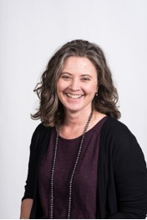
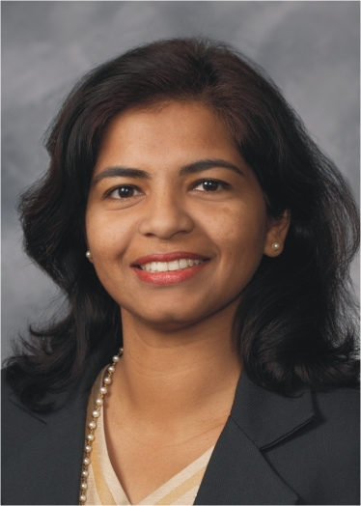
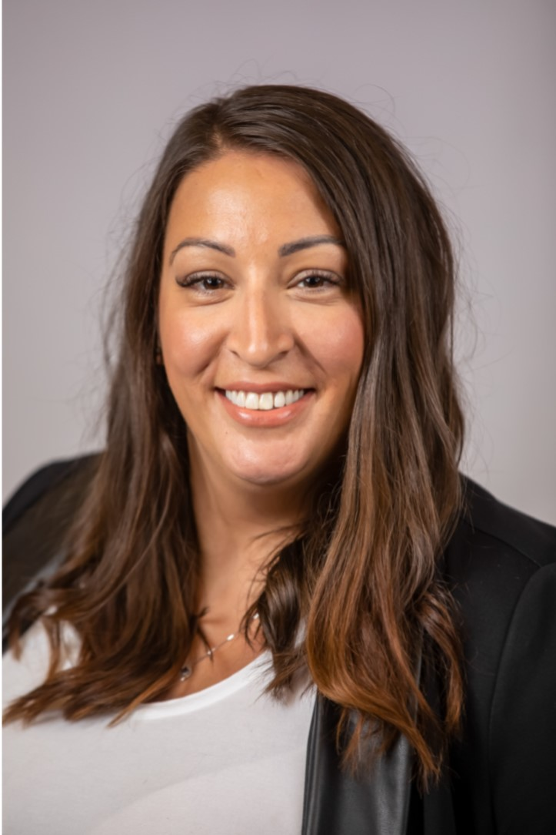
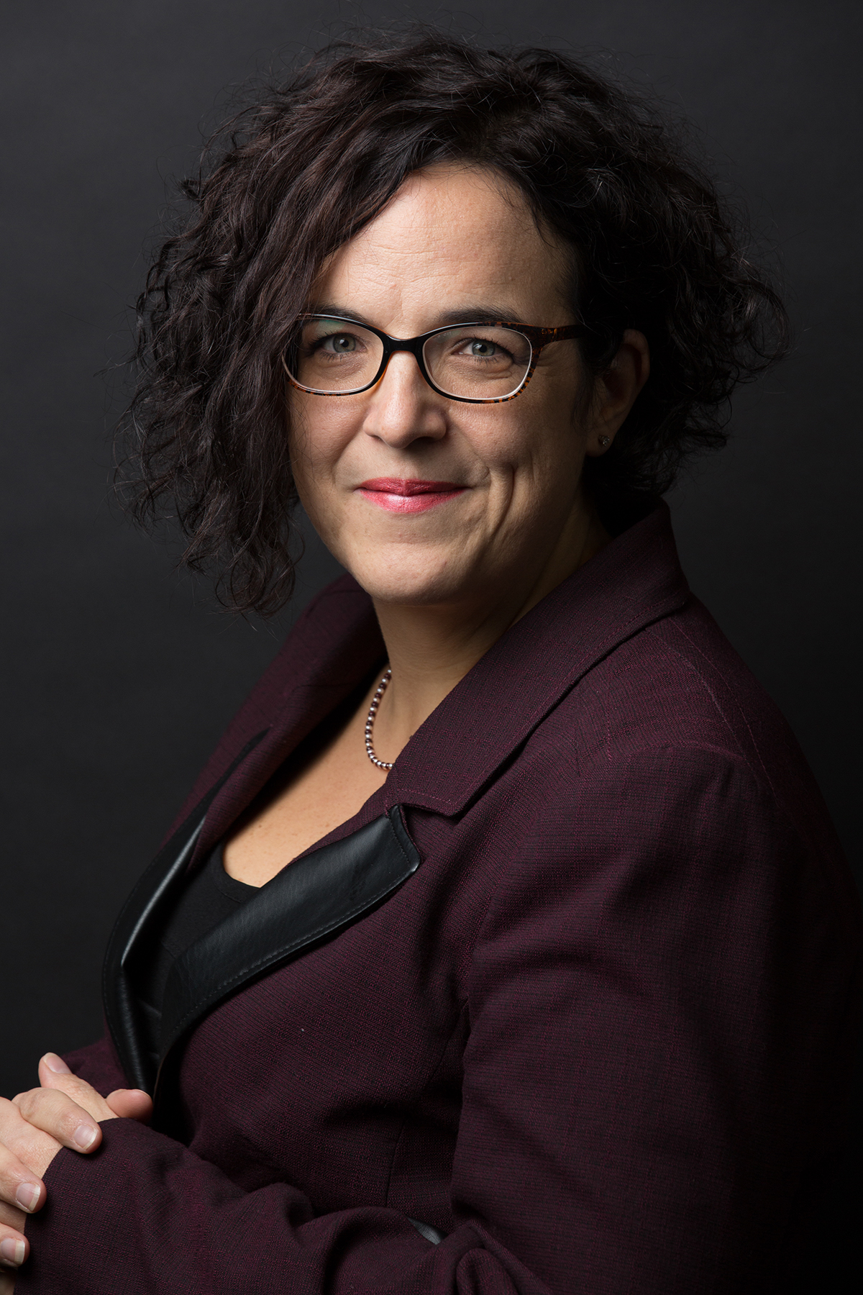
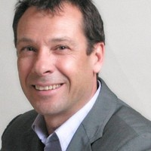

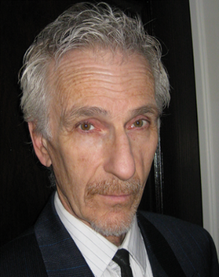
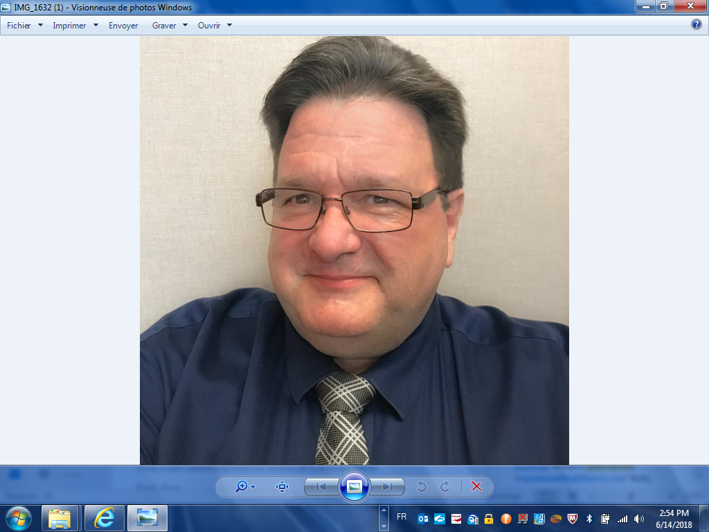
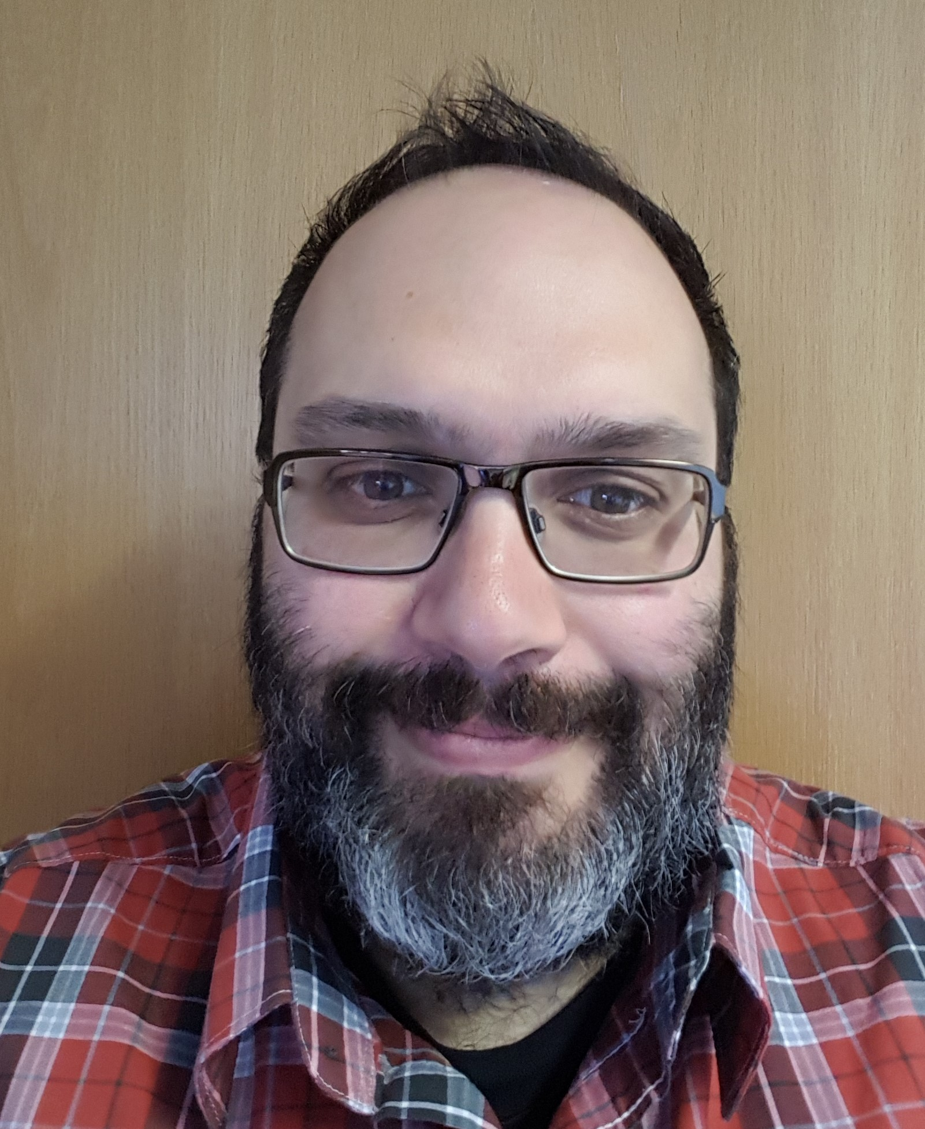
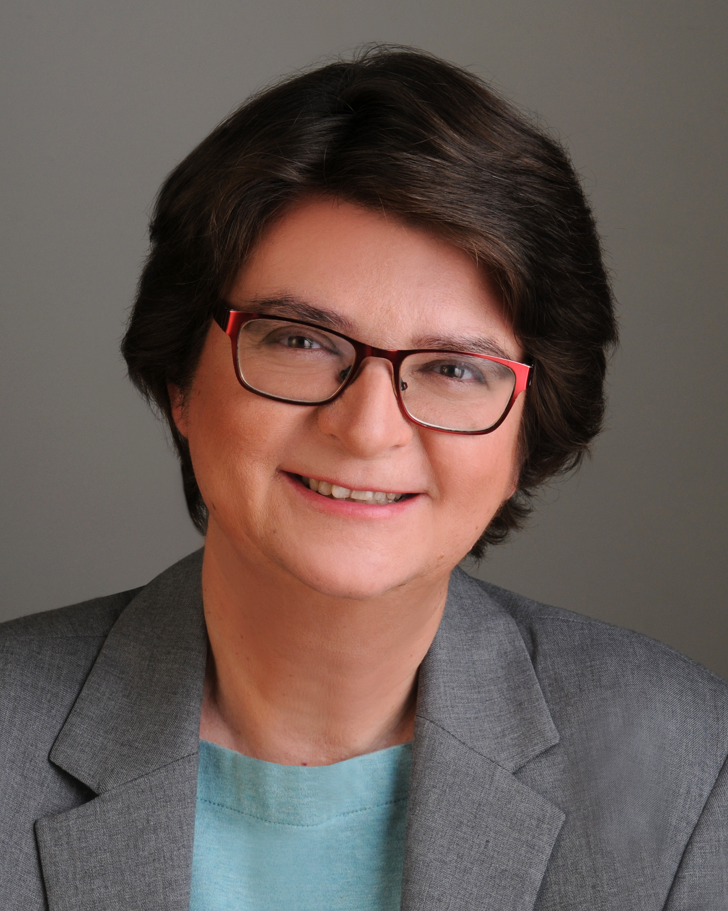
PRESIDENT’S REPORT
2019-2020 BOARD OF DIRECTORS
Michele Kutz
ROH-Central
& Western Prov.
(2017-2020)
Shamini Samuel
ROH-Central
& Western Prov.
(2018-2021)
Sarah McCurdy
ROHT-Central
& Western Prov.
(2018-2021)
Lucie Marcotte
ROH-Quebec
(2019-2022)
Marc Andre Lavoie
ROH-Quebec
(2018-2021)
Matthew Brewer
ROHT-Eastern
(2019-2022)
Mike Welsh
ROH-Ontario
(2017-2020)
Richard Quenneville
ROH-Ontario
(2018-2021)
Roberto Sgrosso
ROH-Atlantic Provinces
(2019-2022)
Liz Krivonosov
Registrar

Slide 9
PRESIDENT'S REPORT
2019 – 2020 Highlights
New Secretariat – Ms. Leah McCormick
Strong effort on Promotion (banners), presence at conferences, new seal, and new frames
New online membership database (Wild Apricot) and new website
Work has begun on translation of website to French
Review of Oral Exam process to assess sustainability of future examiners
Reception in Halifax – pre COVID
Meetings with IOHA AGM, OHAO, BCRSP & ASHSP
Reviewing membership
New retirement policy for membership retention – Marc-André

Slide 10
VICE PRESIDENT’S REPORT
MARC-ANDRÉ LAVOIE

Slide 11
VICE PRESIDENT’S REPORT
Update manual
Bilingual policy
Retirement policy

Slide 12

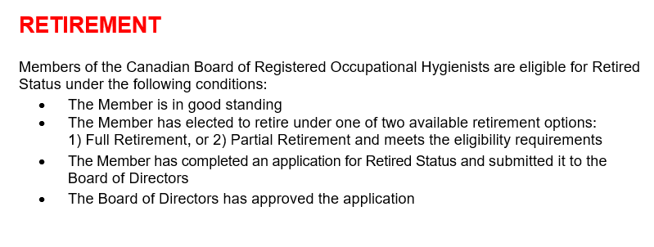
VICE PRESIDENT’S REPORT

Slide 13
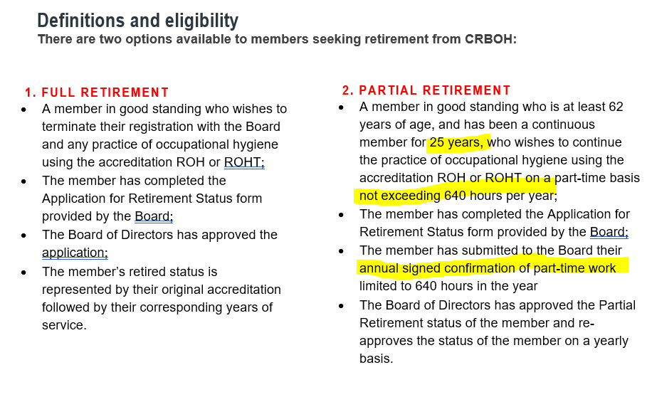
VICE PRESIDENT’S REPORT

Slide 14
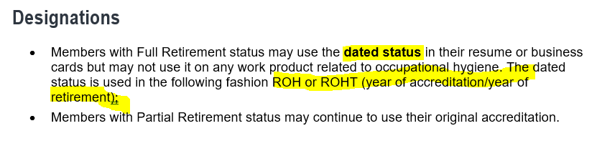
VICE PRESIDENT’S REPORT

Slide 15
TREASURER’S REPORT
SARAH MCCURDY

Slide 16
TREASURER'S REPORT
Financial Position
ASSETS-Current | 2017 | 2018 | 2019
Cash and cash equivalents | $116, 061 | $50,870 | $39,731
Short term investments | $20,066 | $30,689 | $15,916
Prepaid expenses | $2,979 | $9,066 | $4,953
TOTAL | $139,106 | $90,625 | $60,600
Audited Financial Statement
LIABILITIES -Current | 2017 | 2018 | 2019
Accounts payable and accrued liabilities | $5,844 | $7,068 | $5,970
Deferred Revenue | $25,420 | $35,670 | $34,750
TOTAL | $31,264 | $42,738 | $40,720

Slide 17
TREASURER'S REPORT
Statement of Revenue
Audited Financial Statement
REVENUE | 2017 | 2018 | 2019
Exam Fees | $8,150 | $6,675 | $4,700
Membership Dues | $70,065 | $70,200 | $66,845
Job Postings/Stamp Sales | $6,000 | $4,000 | $8,882
Interest Income | $149 | $783 | $845
TOTAL | $84,364 | $81,658 | $81,272

Slide 18
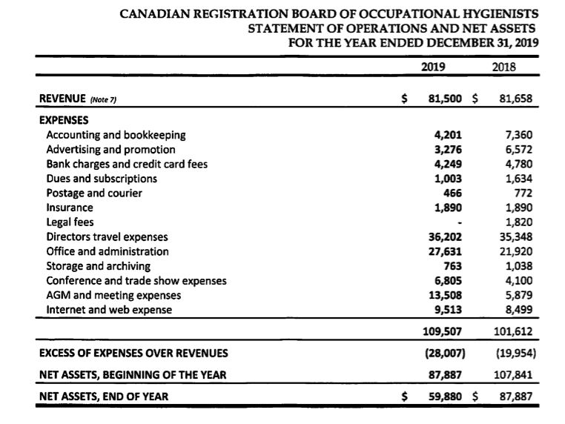
TREASURER'S REPORT
Statement of Operations and Net Assets

Slide 19
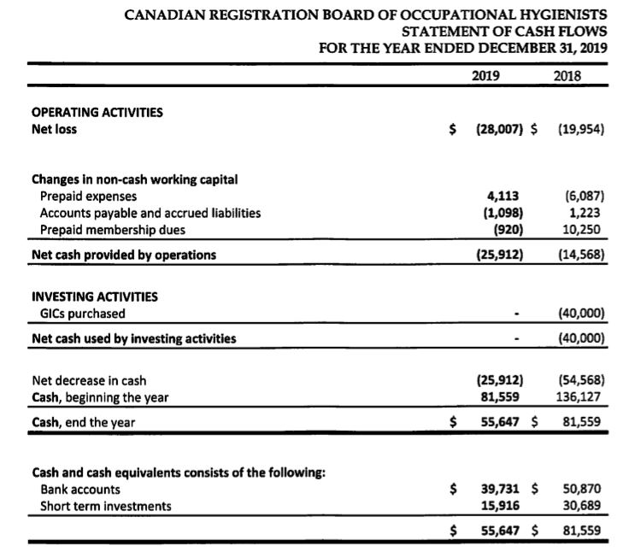
TREASURER'S REPORT
Statement of Cash Flows

Slide 20
TREASURER'S REPORT
Turner and Moore audited our financial position as of December 31, 2019
Financial statements present fairly
Operations and cash flows for 2019 ended in accordance with Canadian accounting standards for non-profit organizations
Independent Auditor’s Report
Appointment of Auditor for 2020 - Scarrow & Donald, Manitoba

Slide 21
MOTION TO APPROVE 2019 AUDITOR’S REPORT
Motion to approve 2019 Audit
Second to approve 2019 Audit

Slide 22
MOTION TO APPOINT SCARROW & DONALD FOR THE 2020 AUDIT
Motion to appoint Auditor for 2020
Second to appoint Auditor for 2020

Slide 23
REGISTRAR’S REPORT
LIZ KRIVONOSOV

Slide 24

REGISTRAR’S REPORT
5 EXAMINATION TYPES
Membership comprised of:
  - Renewals of current members
  - Examinations
ROHT
M/C & Essay
NAR
Oral
ROH
M/C & Essay
Oral
ROH Fast Track 1
M/C only
ROH Fast Track 2
Essay Only

Slide 25


WHAT DOES OUR MEMBERSHIP LOOK LIKE ACROSS CANADA

Slide 26
Total Membership: 2010-2019

Slide 27
Total Exam Candidates
(2015-2020)
2020 Exam not conducted

Slide 28
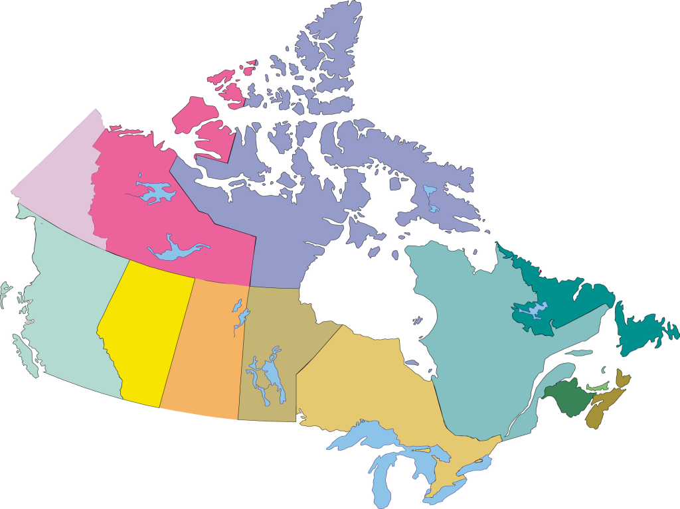
ROHT 2019
Total: 65
Retired in 2019: 2
International: 0
1
8
32
1
1
1
3
1
14
3

Slide 29

REGISTRAR'S REPORT
New CRBOH ROHT Members 2019
Congratulations and welcome to our newest ROHT members (2019):
Taylor Burgess
Tjaart Lombard
Jessie Richards
Brad Schmermund

Slide 30
ROH 2019
Total: 251
Retired in 2019: 11
International: 20
0
31
40
4
8
2
0
22
4
109
11

Slide 31
REGISTRAR’S REPORT
NEW ROH MEMBERS
WRITTEN ROH
Kiet Nguyen
NAR ROH
Theresa Fralic
Ken Major

Slide 32
COMMITTEE REPORTS

Slide 33
EXTERNAL AFFAIRS REPORT
SHAMINI SAMUEL & MARC-ANDRÉ LAVOIE & MICHELE KUTZ

Slide 34
EXTERNAL AFFAIRS
Recognition of the OH&S profession
Alberta initiative – Alberta Society of Health & Safety Professionals
CRSP/CSSE initiatives
IOHA
Suggestion for the ISO17024

Slide 35
COMMUNICATIONS COMMITTEE REPORT
MICHELE KUTZ & SARAH McCURDY

Slide 36
COMMUNICATIONS REPORT
September 2019: an email was sent to our membership for volunteers to help produce a CRBOH newsletter
October 2019: newsletter committee members developed a newsletter editorial plan
November 2019: Newsletter emailed to members
February 2020: Newsletter emailed to members

Slide 37
COMMUNICATIONS REPORT
Thank you to our committee volunteers, collaborators and content providers!

Slide 38
ROH & ROHT EXAM COMMITTEE REPORTS
CHAIR: PAUL BOZEK (ROH COMMITTEE) / DAVE JARRELL (ROHT COMMITTEE)
BOD LIAISON: SHAMINI SAMUEL/SARAH MCCURDY

Slide 39
ROH EXAM COMMITTEE REPORT
WRITTEN EXAM LOCATIONS (MARCH 2019; 2020 Exam Deferred)
2019-2020 COMMITTEE MEMBERS
Andrea Janzen
Andrea Sass-Kortsak
Carl Woychuk
Cindy O’Brien
Kathy Smolynec
Sanda Deike
Subhash Danekar
Toronto
Calgary
Vancouver
Ottawa
Winnipeg
Saskatoon
Montreal

Slide 40
ROH EXAM COMMITTEE REPORT
CHIEF ORAL EXAMINERS (COE)
ORAL EXAM (OE) PANEL MEMBERS
Andrea Sass-Kortsak
Lydia Renton
Guillaume Lachapelle
Toronto
  - Cindy O’Brien
  - Paul Bozek
  - Yang Ting Shek
Ottawa
  - Darren McPherson
Halifax/St.John’s
  - Jason MacInnis
Calgary
  - Tiffany Clayton
  - Shamini Samuel

Slide 41
ROH EXAM COMMITTEE REPORT
Project Participants
Answer Key Project
Andrea Sass-Kortsak
Lydia Renton
Guillaume Lachapelle
Tiffany Clayton
Michel Crepeau
Darren McPherson
Shamini Samuel
July 2019
12 ROH Oral exam questions were reviewed

Slide 42
ROHT EXAM COMMITTEE REPORT
2019 -2020 COMMITTEE MEMBERS
Chair: Dave Jarrell
BOD Liaison: Sarah McCurdy
ROHT Exam Process
  Independent and separate from the ROH Exam
David Jarrell and the Registrar have copies of the exam questions
David makes the exam and sends to the proctors
ROHT is kept separate from the ROH influence
Call out for new committee members and new question submissions (eligible for CM points)
Corry Devos
Pierre Frenette
WRITTEN EXAM LOCATIONS (MARCH 2019; 2020 Exam Deferred)
Calgary
Newfoundland

Slide 43
REGISTRATION MAINTENANCE
POINTS COMMITTEE REPORT
CHAIR: JODI JOHNSON BOD LIAISON: MATTHEW BREWER & ROBERTO SGROSSO

Slide 44
ROH REGISTRATION MAINTENANCE
 | ROHs
# Due for RM in 2019: | 41
# Worksheets submitted: # Successful # Under review audit # Reviews pending (pass/fail) | 29 (71%) 24 2 2
# Worksheets NOT submitted: | 12 (29%)
# Worksheet submitted NOT due | 1
Note: June 30th 2020 extension for submission of RM Worksheets
2020 CRBOH Member
Volunteers
Mike Grey
Anjie Davis
Kathy Rohl

Slide 45
ROHT REGISTRATION MAINTENANCE
 | ROHTs
# Due for RM in 2019: | 6
# Worksheets submitted: # Successful # Under review audit # Reviews pending (pass/fail) | 6 (100%) 6 0 0
# Worksheets NOT submitted: | 0
# Worksheet submitted NOT due | 0
Note: June 30th 2020 extension for submission of RM Worksheets
2020 CRBOH Member
Volunteers
Matthew Brewer
Jodi Johnson

Slide 46
REGISTRATION MAINTENANCE POINTS REPORT
21
2019
Of the 21 events, not all events are up on the website yet
2020
There are approximately five requests for events to be reviewed to date
 | 2014 | 2015 | 2016 | 2017 | 2018 | 2019
Course and Events Approved | 116 | 98 | 27 | 31 | 20 | 21

Slide 47
PROMOTIONS COMMITTEE REPORT
CHAIR: MICHAEL WELSH
BOARD MEMBER: SHAMINI SAMUEL
VOLUNTEER: ERIN PIERCE

Slide 48
PROMOTIONS COMMITTEE
To promote the mission of CRBOH to various stakeholders and interest groups including prospective registrants, CIH’s, other Occupational Hygiene organizations, allied professions, companies, and government agencies.
Responsible for recommending promotional activities to BOD.
Objective

Slide 49
PROMOTIONS COMMITTEE
Conference Booth Banners distributed to and used by Directors in:
- Quebec
- Ontario
- Alberta
- New Brunswick/Nova Scotia
AIHCE 2019 Minneapolis
Activities

Slide 50
PROMOTIONS COMMITTEE
Updating core Promotions powerpoint presentation for adaptation to various audiences.
Mike delivered the powerpoint presentation adapted for the title protection case to a fine turnout at the Halifax Club for the February 2020 BOD Meeting.
Completed spreadsheet report on the Jurisdictional Scan results from CAALL-OSH to summarize references to Occupational Hygiene in all FPT jurisdictions (used in title protection review and PPt presentation)
Collaboration with new “Retirement Status” Cttee.
CRBOH Newsletter inputs.
Activities

Slide 51
PROMOTIONS COMMITTEE
Promotion of our Website Job-Ads feature to increase revenues. Includes discount for members’ company ads.
Members are asked to contact CRBOH Secretariat with info on external source Job-Ads to permit direct contact about our service to the company advertising.
Promotional Materials including new CRBOH lapel pins and service recognition pins: on hold; budget restrictions.
Activities

Slide 52

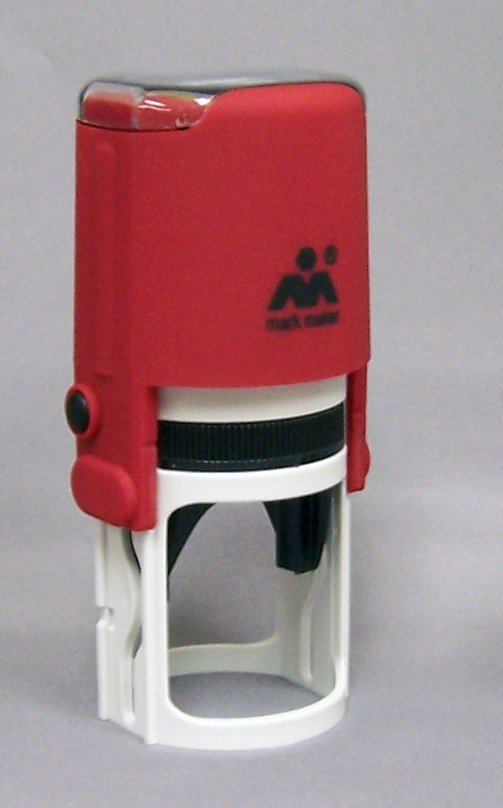
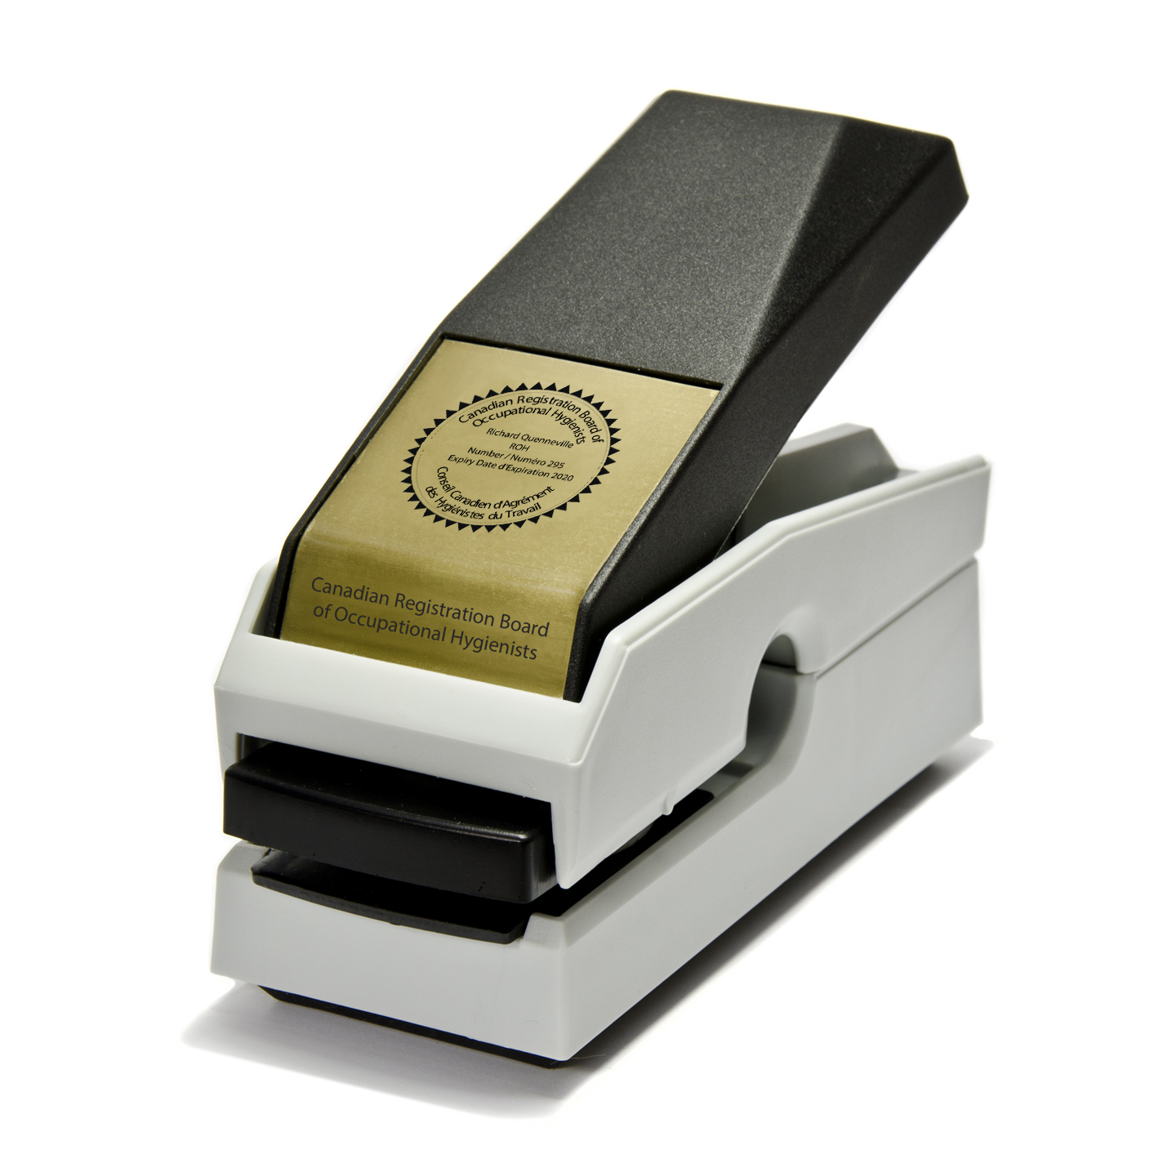
CRBOH Merchandise
A new page on the CRBOH website recently launched, featuring custom frames for sale, in addition to the self inking stamp and seal embosser.
Two styles of custom frames are now available for purchase online.
Notes:
Order from CRBOH website; self inking stamp $50 + HST; embosser seal $65 = HST; replacement ink pads $$7.99 shipping $16

Slide 53
PROMOTIONS COMMITTEE
Volunteer Recognition
Recognizing the hard work of our excellent Cttee volunteer Erin Pierce ROHT; letter and Points awarded.
2020 Student Award
This year our student award winner was:
  Meriem Bessadet
  Université de Montréal
Activities

Slide 54
NEW BUSINESS
NEW AND OUTGOING DIRECTORS
MARC-ANDRÉ LAVOIE

Slide 55

INCOMING PRESIDENT
2020 – 2021
Marc-André Lavoie

Slide 56
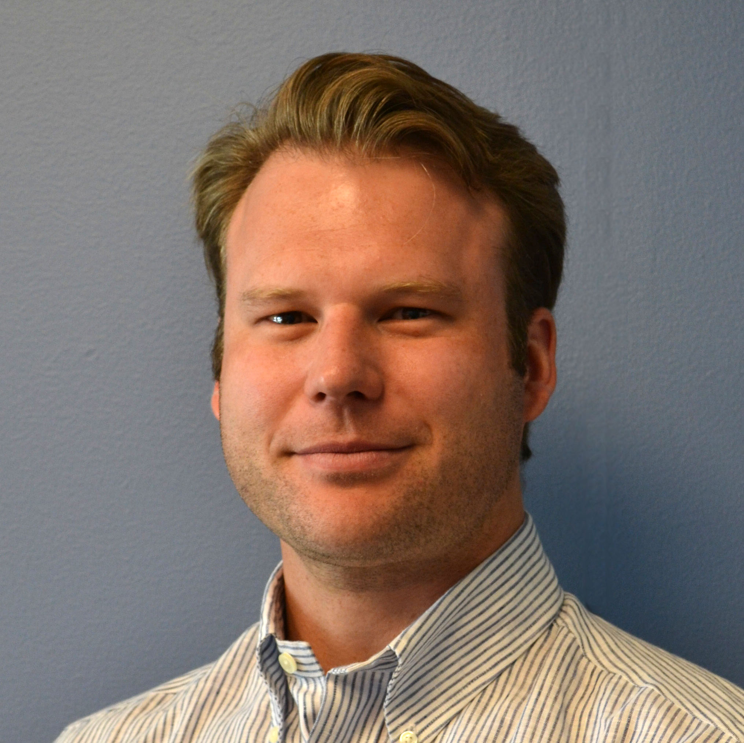
NEW DIRECTORS
ROH – CENTRAL & WESTERN
Spencer Matthes, Alberta
2020 – 2023
Spencer Matthes is a senior consulting Industrial Hygienist and Safety/Risk Specialist with 10 years of HSE industry experience and 20 overall years in the workforce. During this time he has provided HSE support to the construction/demolition, oil & gas, municipal/institutional, healthcare, academic research, mining/quarrying, manufacturing, and food processing industries.
He holds a Master of Science Degree in Occupational Health and Safety with a Concentration in Environmental Management, as well as currently completing a second Master of Science Degree in Safety and Risk Management. Besides being an ROH, he is also a professional member of the BCSP (ASP & CSP designations) and ECO Canada (EP designation).

Slide 57
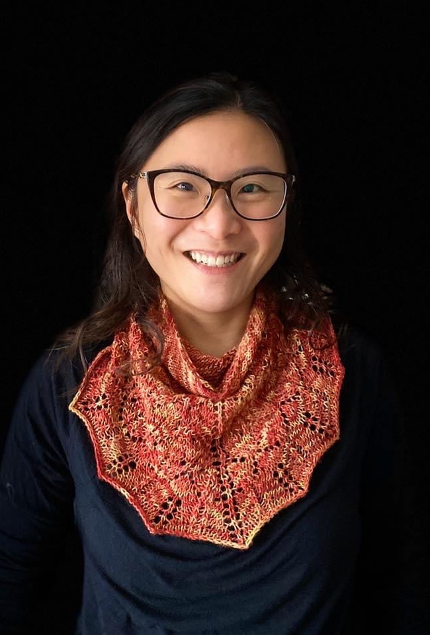
NEW DIRECTORS
ROH – ONTARIO
Letty Wong
2020 - 2023
Letty Wong is a ROH and CIH with almost 20 years of experience in the field of Occupational Hygiene. She graduated with a MHSc. in Occupational and Environmental Health from the University of Toronto. Since then, she has spent the majority of her career working in OH consulting. She spent the first part of her career with Resource Environmental Associates as an occupational hygiene consultant. More recently, she was the manager of the IH/OHS group and a Senior Industrial Hygienist at the consulting firm BluMetric Environmental Inc. (formerly WESA).
Currently Letty is the EHS Lead for Canada at Apple. In this role, she manages and oversees all matters of health and safety related to Apple's retail and corporate operations in Canada. She also provides industrial hygiene expertise in retail operations.
Outside of work, Letty has served as an IH mentor for a number of years at both the Dalla Lana School of Public Health at UofT, and within the Occupational Hygiene Association of Ontario (OHAO). Previous to joining the CRBOH Board, Letty served on the OHAO Board of Directors for six years, and was the association’s President in 2017-2018.

Slide 58
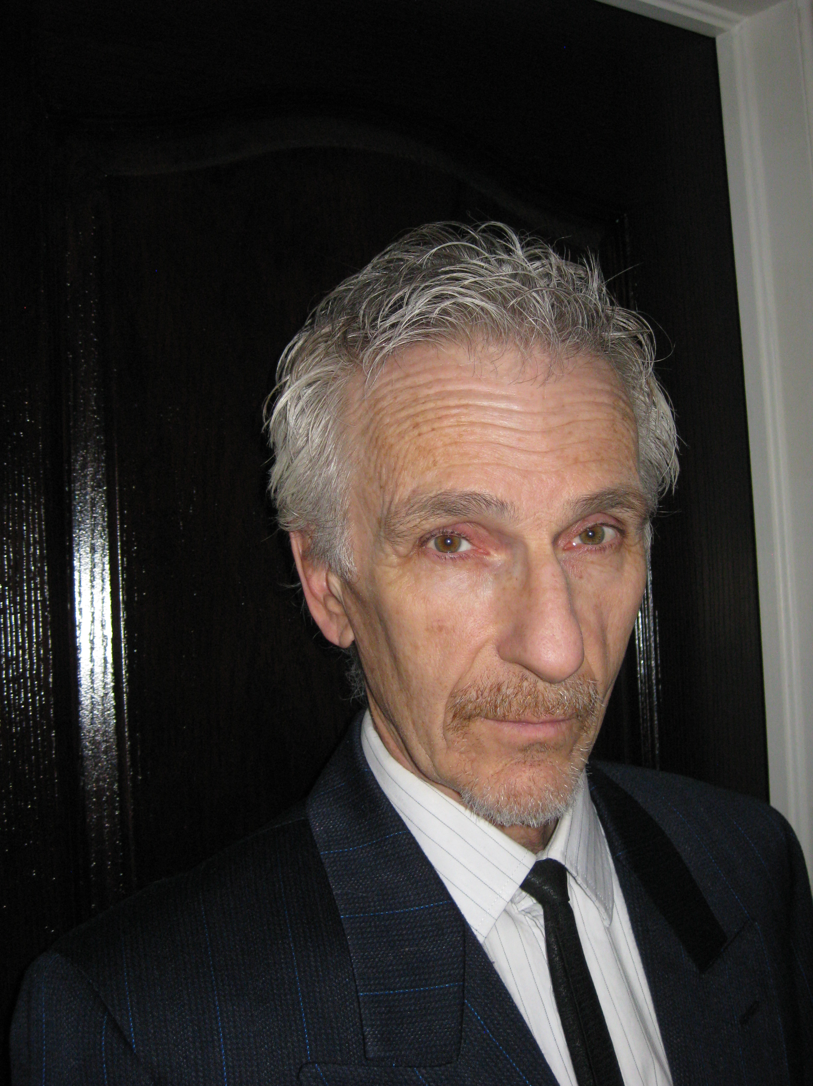
OUTGOING DIRECTORS
MANY THANKS FOR YOUR HARD WORK & CONTRIBUTIONS TO THE BOARD
Michael Welsh, ROH
Ontario)
Michele Kutz, ROH
Central & Western Prov.

Slide 59
2020 Key Priorities
Complete the translation of the website
Positioning the ROH/ROHT in the OHS professionals' current discussions
AIHA new position : OH&S science professionals
ABIH position : Board of EHS credentials
May require a special committee (White paper?)
Encourage stronger bounds with provincials OH associations
Exam review committee
Is our model sustainable?
Maintain/grow financial maturity

Slide 60

Q & A
Please use the chat function if you have a question
Questions can also be emailed to our Secretariat, and will be responded to very soon!

Slide 61
MOTION TO ADJOURN THE CRBOH 33RD ANNUAL GENERAL MEETING
Motion to adjourn

Slide 62

WE WILL NOW TAKE A FIVE MINUTE BREAK
UP NEXT:
GUEST SPEAKER:
DR. VICTORIA ARRANDALE, ROH
Title: Occupational Hygiene in the time of COVID-19
THANK YOU FOR
ATTENDING THE 2020 VIRTUAL AGM

